Slide 1
RTCZ Travel Automation System
October 2024
Created by RTC BSI

Slide 2
Table of Content
1

Slide 3
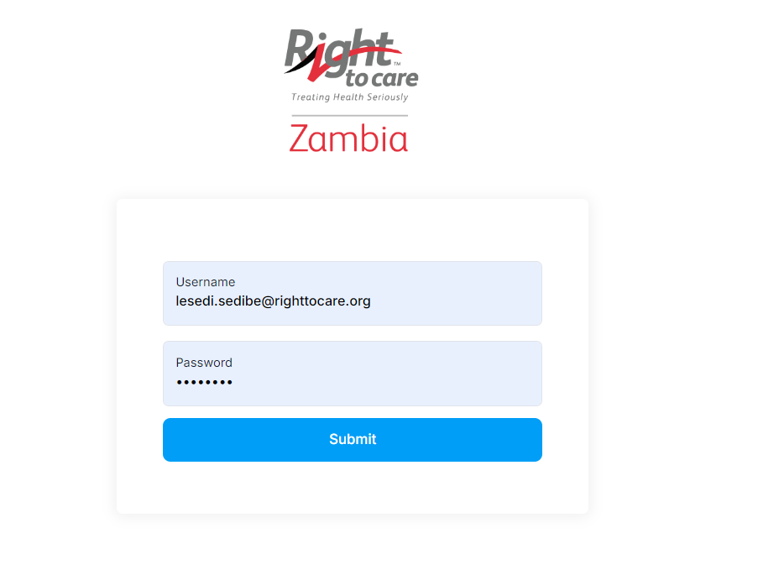
1. System Admin - Login
Capture your email address as the username.
Capture the password from the registration confirmation email.
Click on the submit button to login to the system.

Slide 4
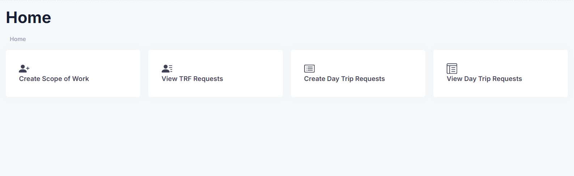
2. Dashboard
You have logged in successfully

Slide 5
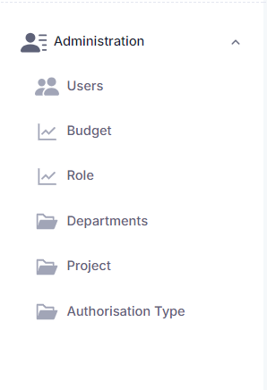
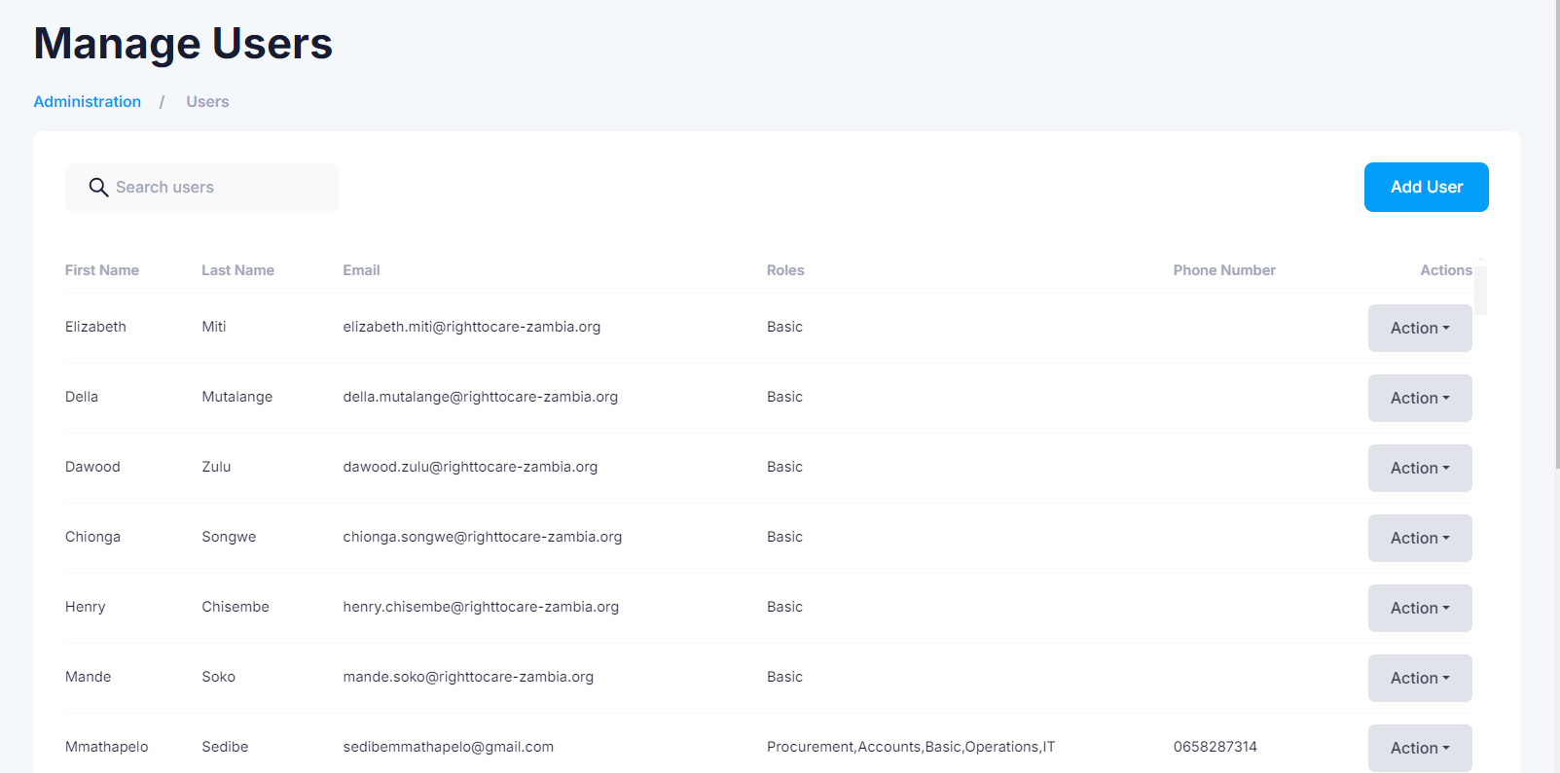
3. Users
Click on “Users” and the system will take you to the “Manage Users” longitudinal view page as shown below.
Click on the “Actions” button to either delete a user or edit their profile.

Slide 6
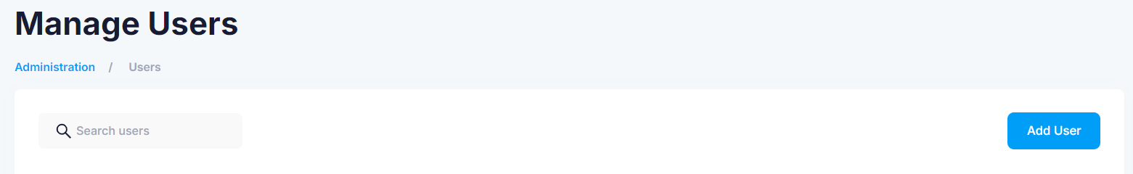
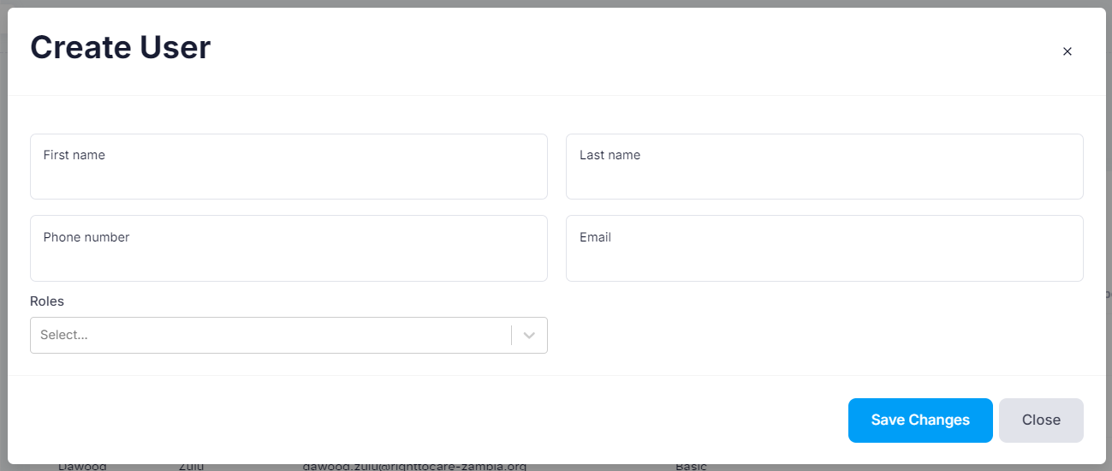
3. Users
Click “Add User” to register a new user into the system.
Capture the new user’s first name, last name, phone number, email and select their role from the dropdown.
Click “Save Changes” to add the user to the system.
Click “Cancel” to return back to the longitudinal view page.

Slide 7
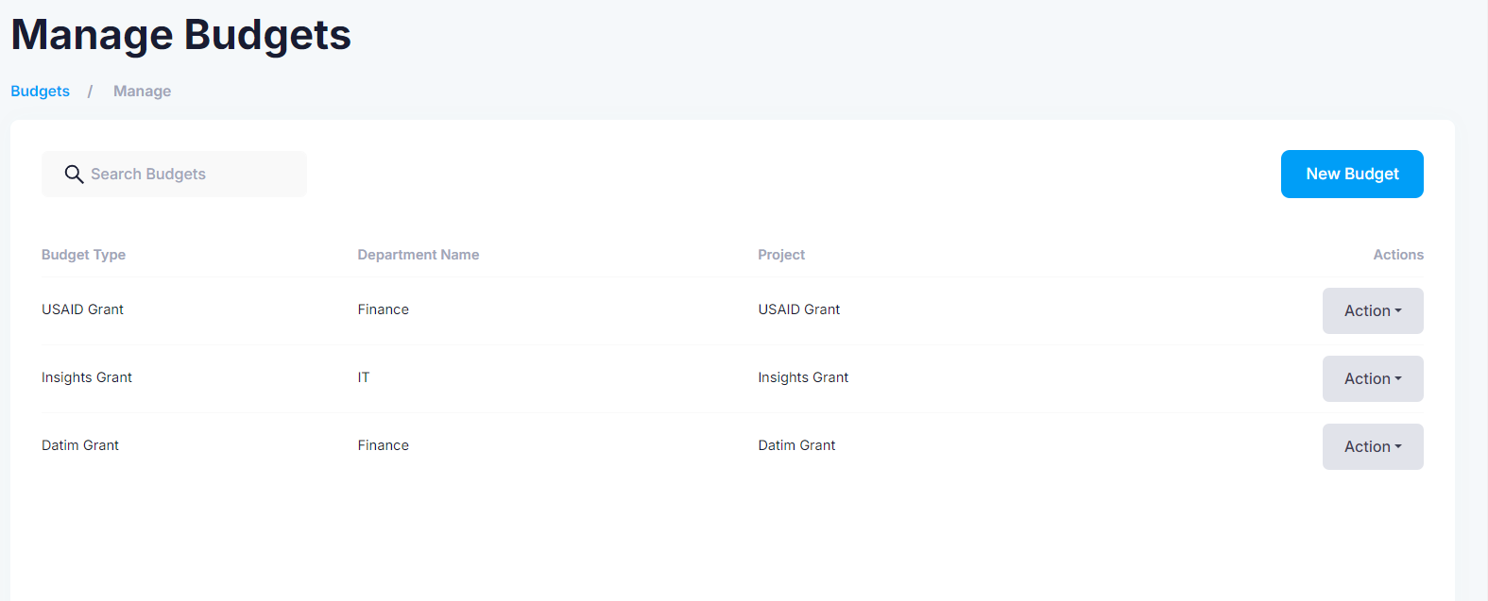
4. Budget
Click on Budget to add a new budget to the system. The system will direct you to the “Manage Budgets” longitudinal view page as shown below.
Click on the “Actions” button to either edit or delete a budget type.

Slide 8
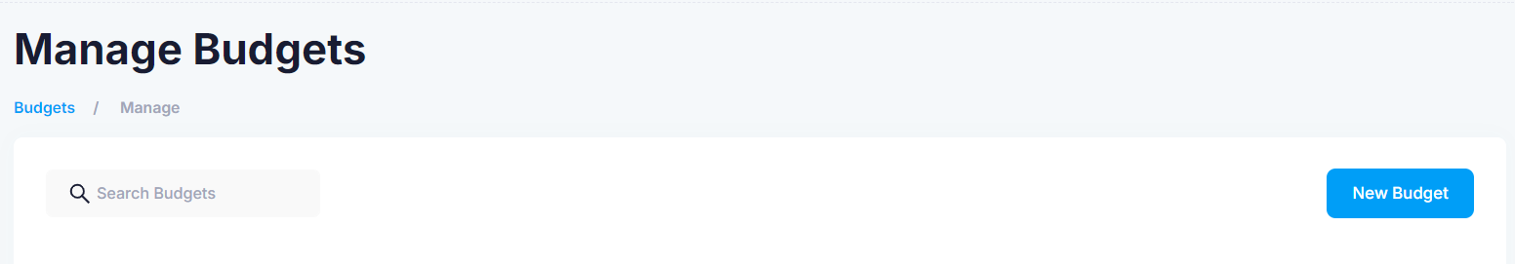
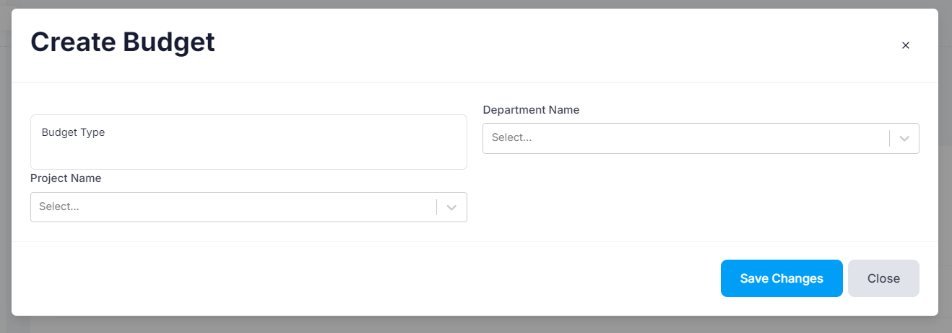
4. Budget
Click “New Budget” to create a new budget type.
Capture the budget type name that you would like to add to the system, and select the department name and the project name from the two dropdowns.
Click “Save Changes” to add the budget name to the system.
Click “Cancel” to return back to the longitudinal view page.

Slide 9
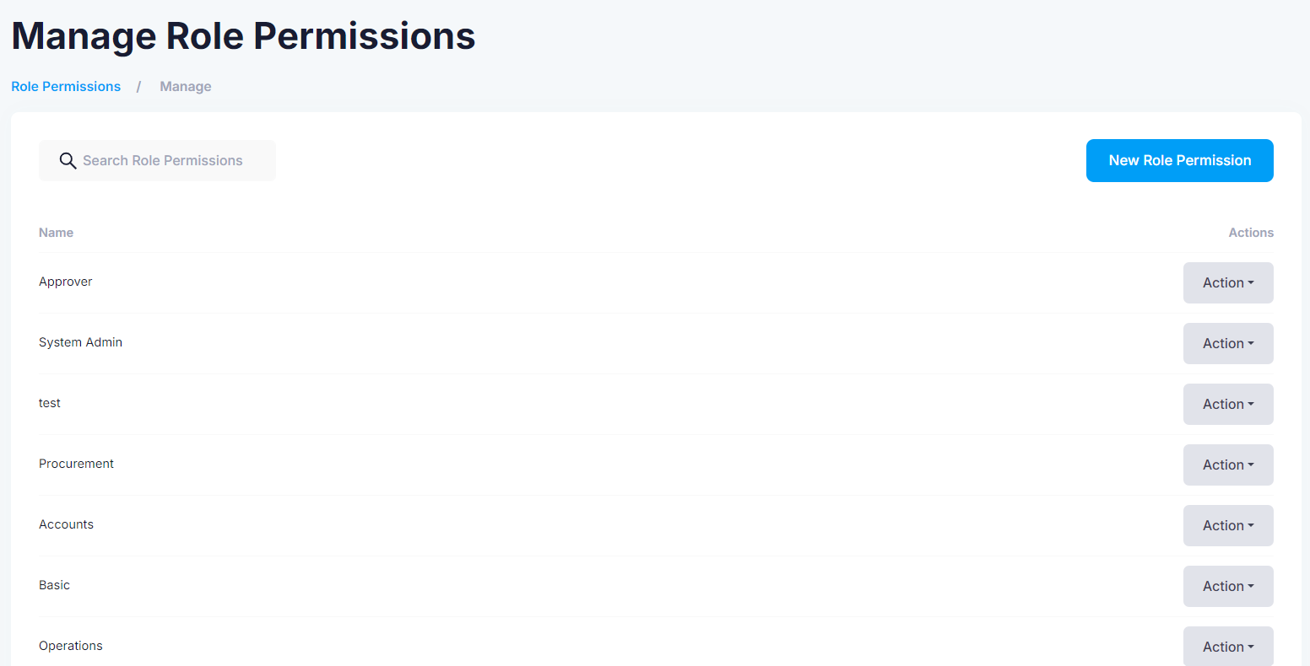
5. Role
Click on Role to add a new role. The system will direct you to the “Manage Role Permissions” longitudinal view page.
Click on the “Actions” button to either delete or edit a role name.

Slide 10
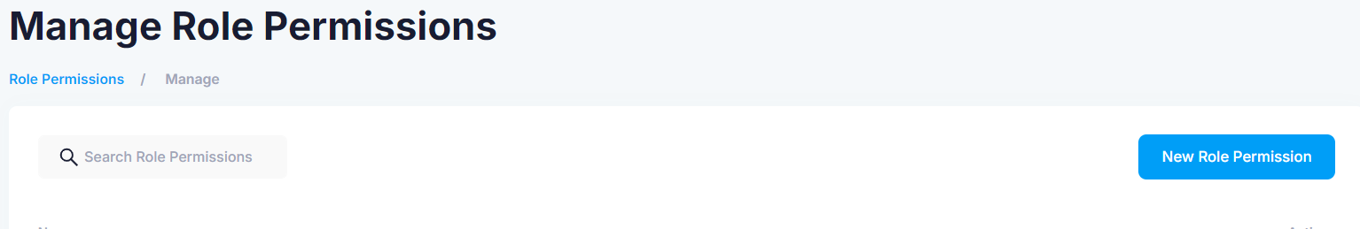
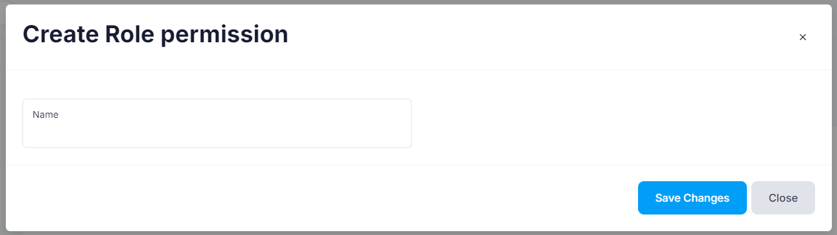
5. Role
Click on “New Role Permission” button.
Capture the new role name.
Click “Save Changes” to save the new role name to the system.
Click “Close” to return to the longitudinal view page.

Slide 11
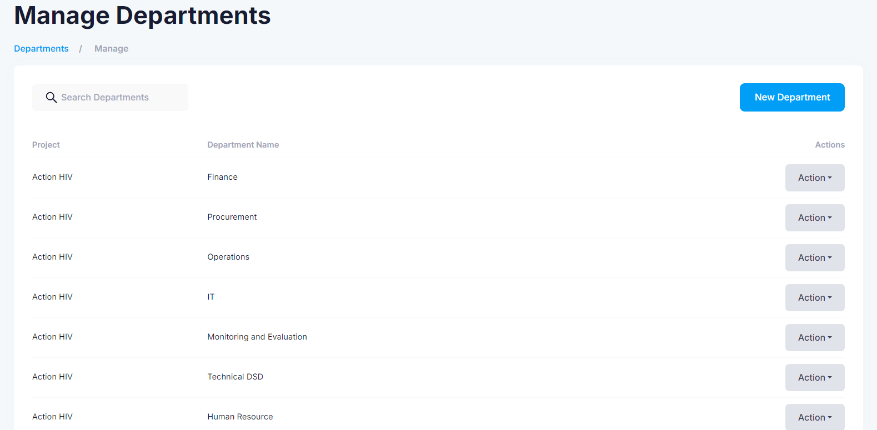
6. Departments
Click on “Departments” to add a new department. The system will then direct you to the “Manage Departments longitudinal view page.
Click on the “Actions” button to either delete or edit a department name.

Slide 12
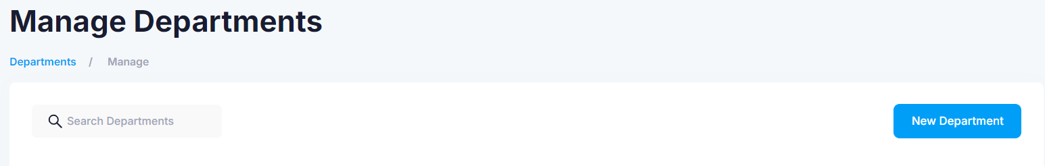
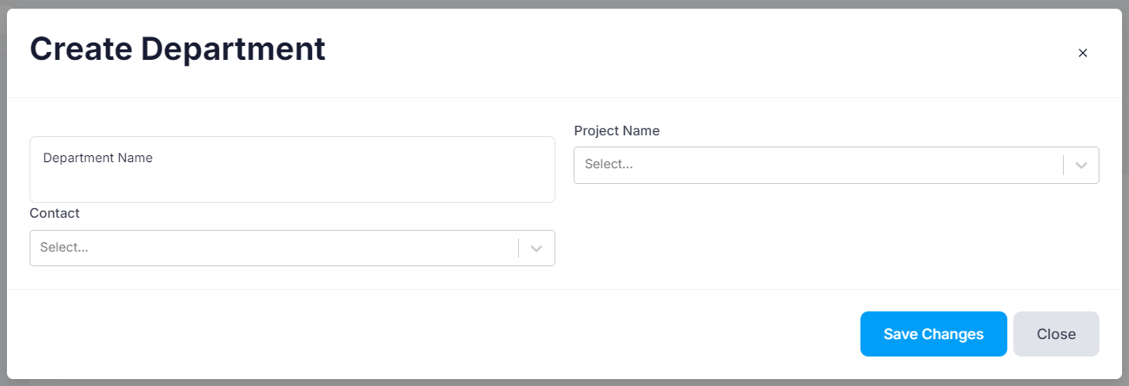
6. Departments
Click on “New Department” button to add a new department.
Capture the department name, and select the project name and the contact from the two dropdowns.
Click “Save Changes” to save the new role name to the system.
Click “Close” to return to the longitudinal view page.

Slide 13
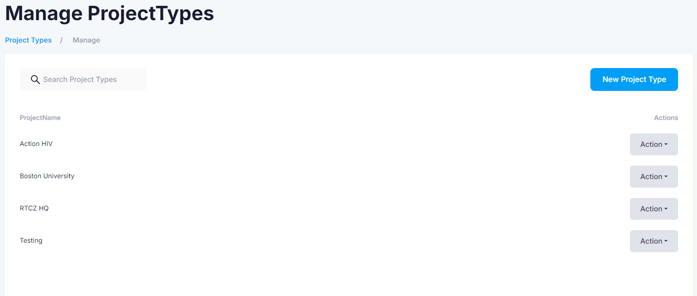
7. Project
Click on “Project” to add a new project. The system will direct you to the “Manage Project Types” longitudinal view page as shown below.
Click on the “Actions” button to either delete or edit a project name.

Slide 14
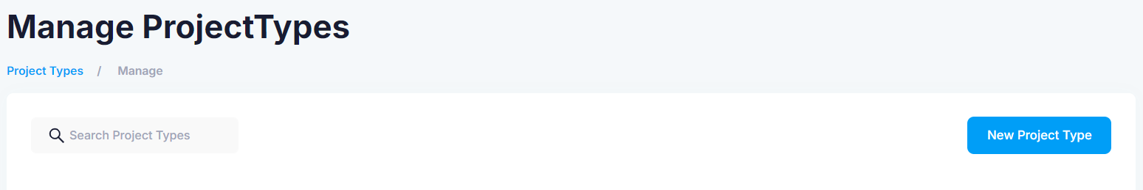
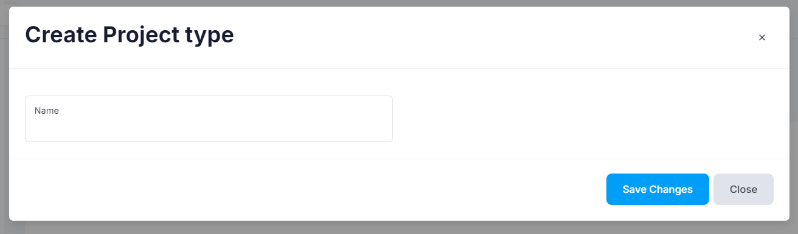
7. Project
Click on the “New Project Type button.
Capture the new project name.
Click “Save Changes” to save the new role name to the system.
Click “Close” to return to the longitudinal view page.

Slide 15
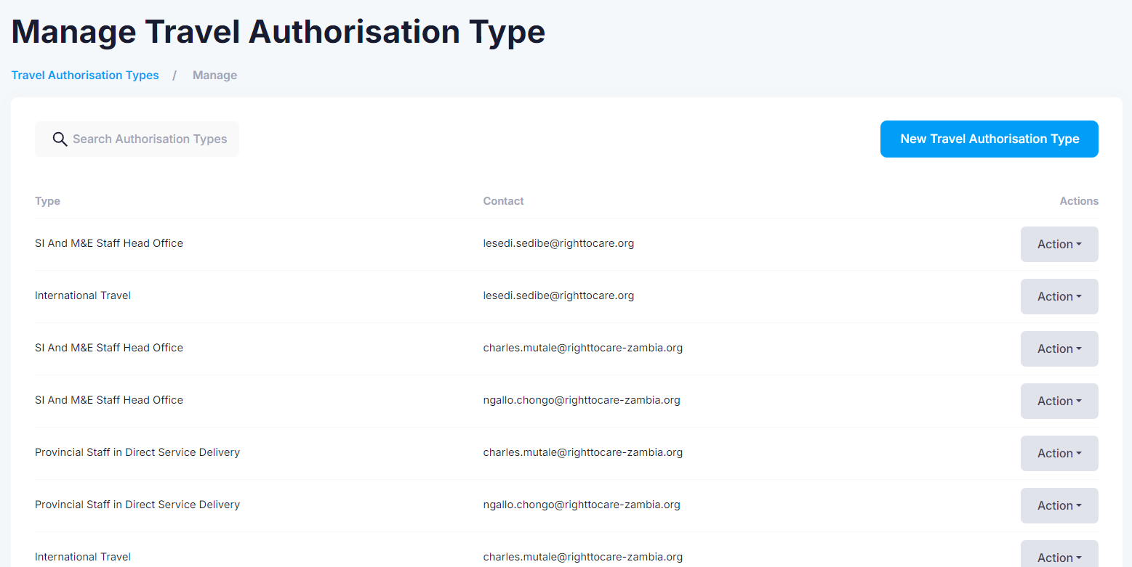
8. Authorization Type
Click on “Authorisation Type”. The system will direct you to the “Manage Travel Authorisation Type” longitudinal view as shown below.
Click on the “Actions” button to either delete or edit a authorization type name.

Slide 16
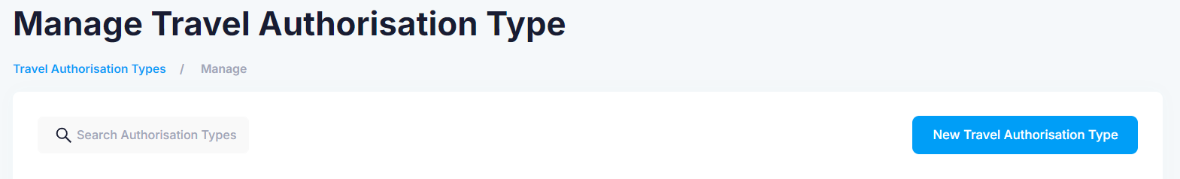
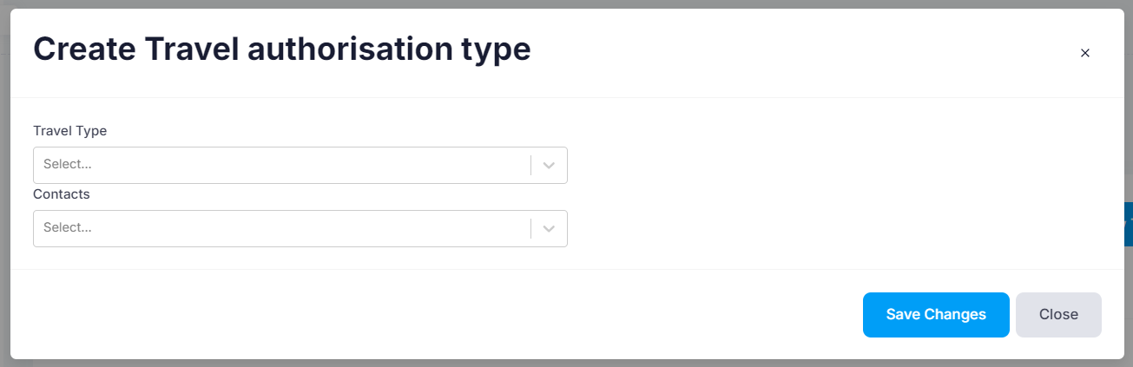
8. Authorization Type
Click on “New Travel Authorisation Type” to add a new one on to the system.
Select the travel type and the contacts from the dropdowns.
Click “Save Changes” to save the new role name to the system.
Click “Close” to return to the longitudinal view page.

Slide 17
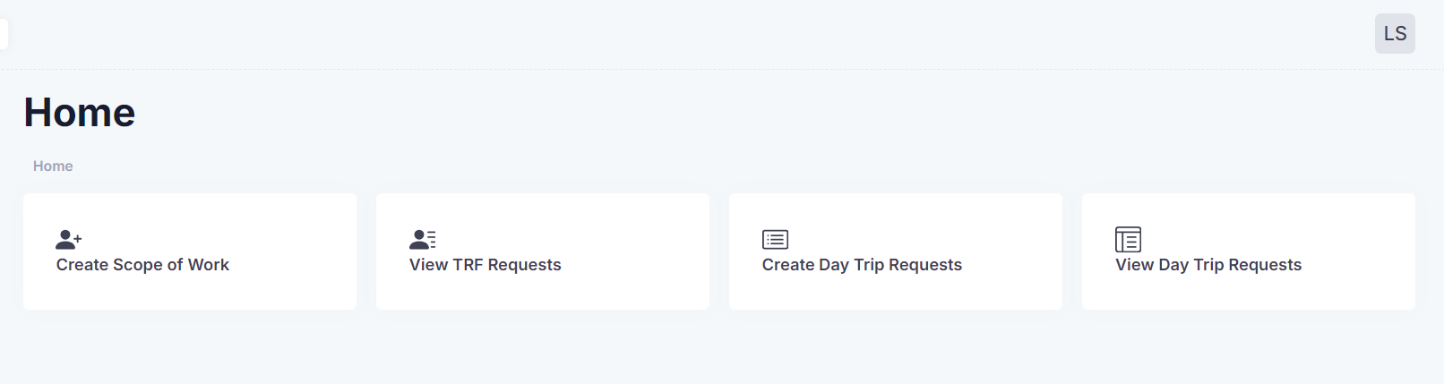
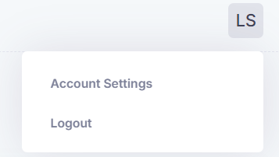
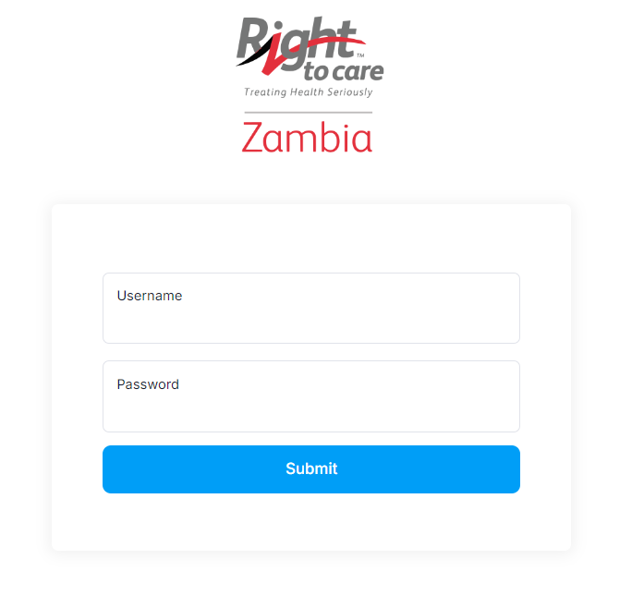
9. Logout
Click on the top right corner.
Click on “Logout”. The system will redirect you back to the login page.

Slide 18
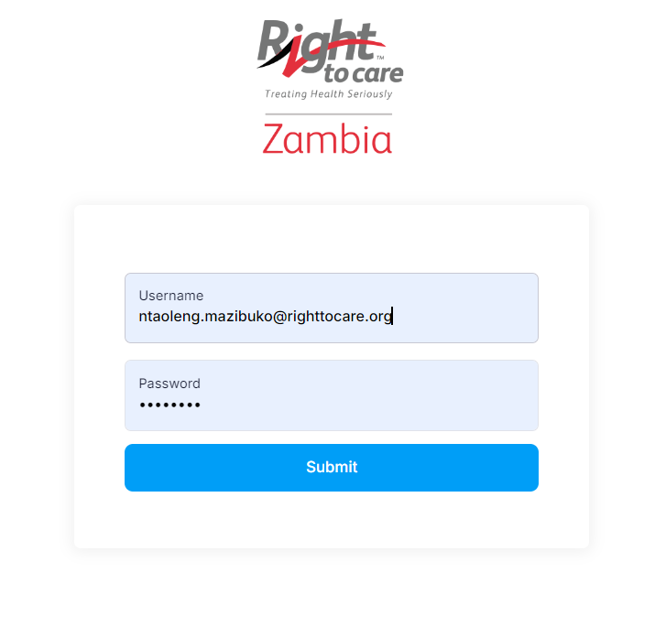
10. Basic Account - Login
Capture your email address as the username.
Capture the password from the registration confirmation email.
Click on the submit button to login to the system.

Slide 19
11. Dashboard
You have logged in successfully

Slide 20
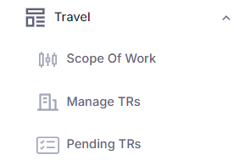
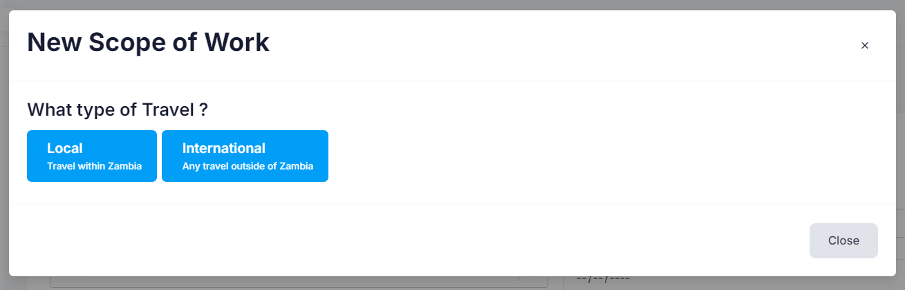
12. Scope of Work
Click on “Scope of Work” on the menu. You can also select the Scope of work on the home/dashboard page.
Click “Close” if you wish not to continue with the scope of work.
The system will prompt you to choose the type of travel.

Slide 21
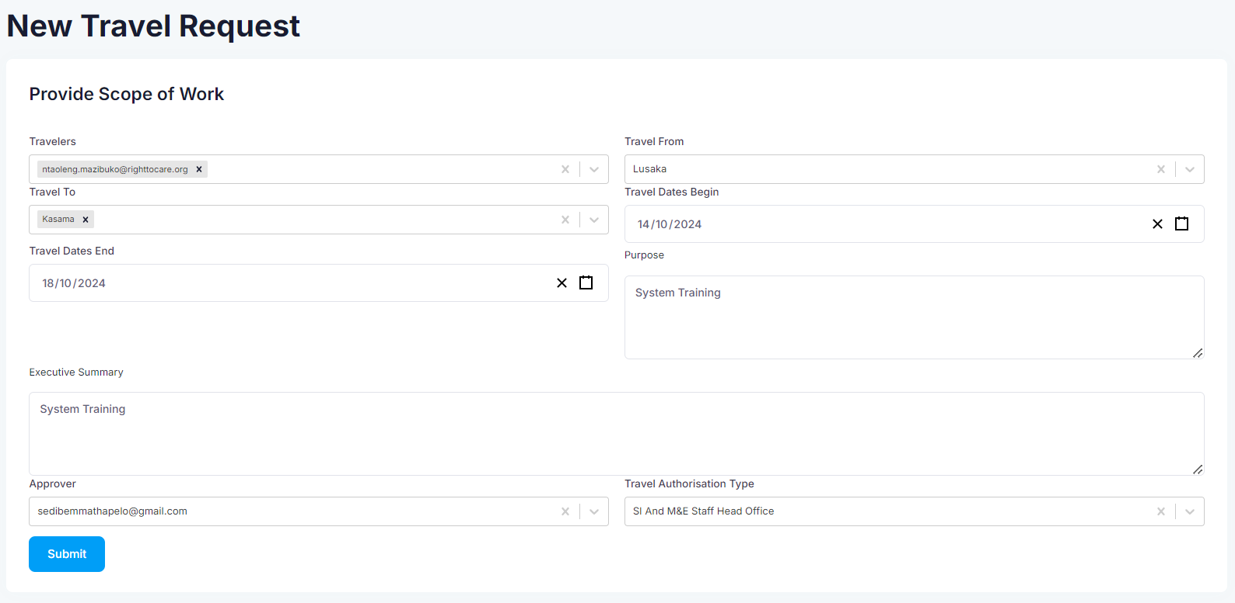
12. Scope of Work
Fill out the Travel Request Form with the correct details.
Click on the submit button once you have completed the form.

Slide 22
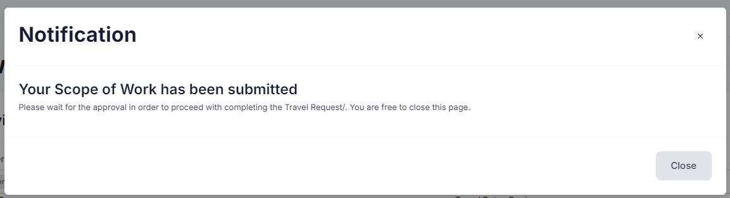
12. Scope of Work
Once you click the submit button, you will see this notification pop-up that lets you know your form has been successfully submitted.

Slide 23
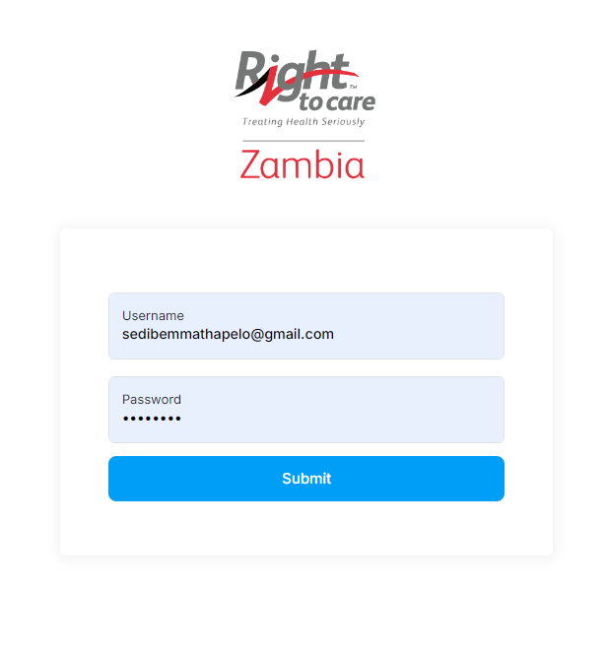
13. Approver - Login
Capture your email address as the username.
Capture the password from the registration confirmation email.
Click on the submit button to login to the system.

Slide 24
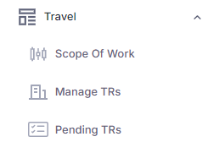
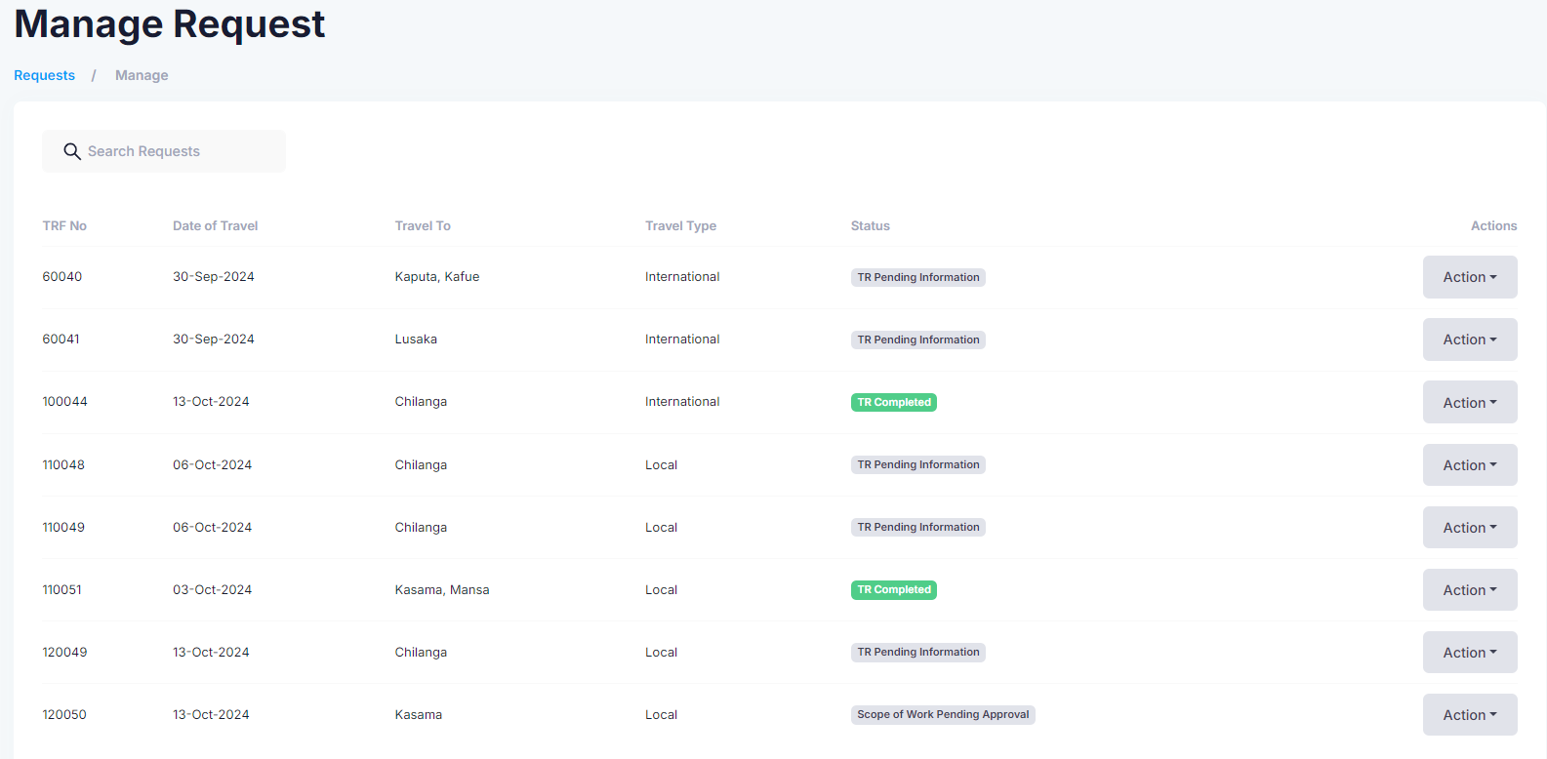
14. Approve Scope of Work
Click on the Manage TRs button. The system will then direct you to the Manage Requests longitudinal view page.
Click on the “Actions” button to either delete or edit a authorization type name.

Slide 25
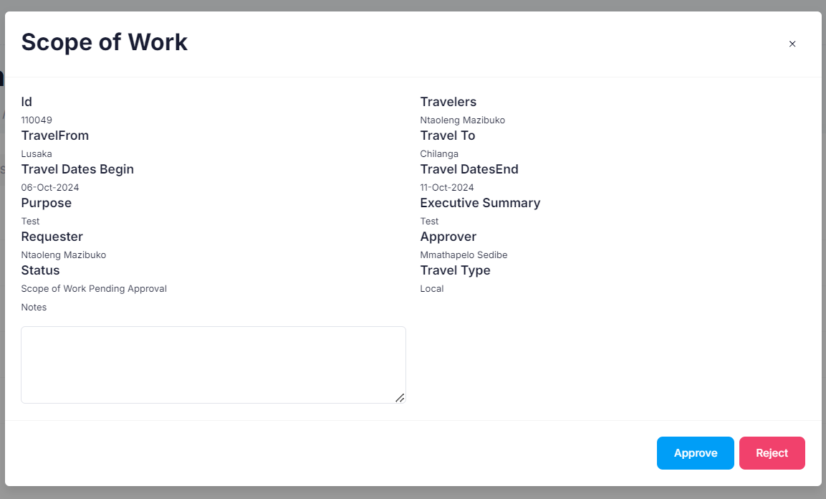
14. Approve Scope of Work
Click on “View Scope of Work” to see the details.
Click on the Respond button to either approve or reject the scope of work.
Click on the approve button once you have gone through the scope of work.
If you reject the scope of work, capture the reason for rejection in the Notes box and click on the rejection button.

Slide 26
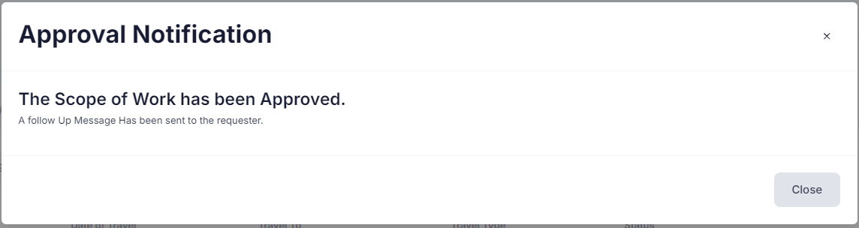
14. Approve Scope of Work
Once the scope of work has been approved, you will get this pop-up notification.

Slide 27
15. Basic Account - Login
Capture your email address as the username.
Capture the password from the registration confirmation email.
Click on the submit button to login to the system.

Slide 28
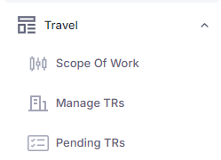
16. Manage TRs
Click on the Manage TRs button. The system will then direct you to the Manage Requests longitudinal view page.
Click on the “Actions” button to view scope of work or complete TRF.

Slide 29
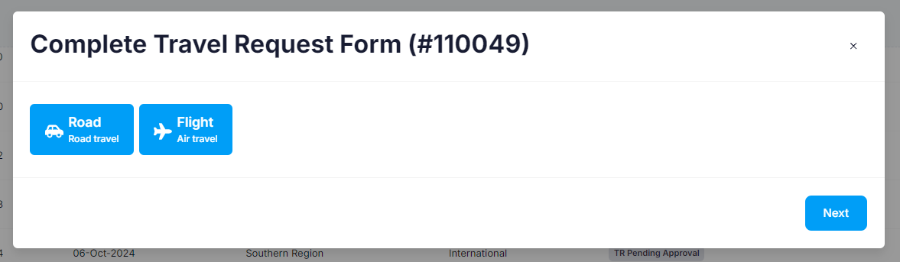
17. Complete TRF
When you click the complete TRF button, the system will prompt you to choose the mode of travel before completing the travel request form.
Click the next button to fill out the travel request form.

Slide 30
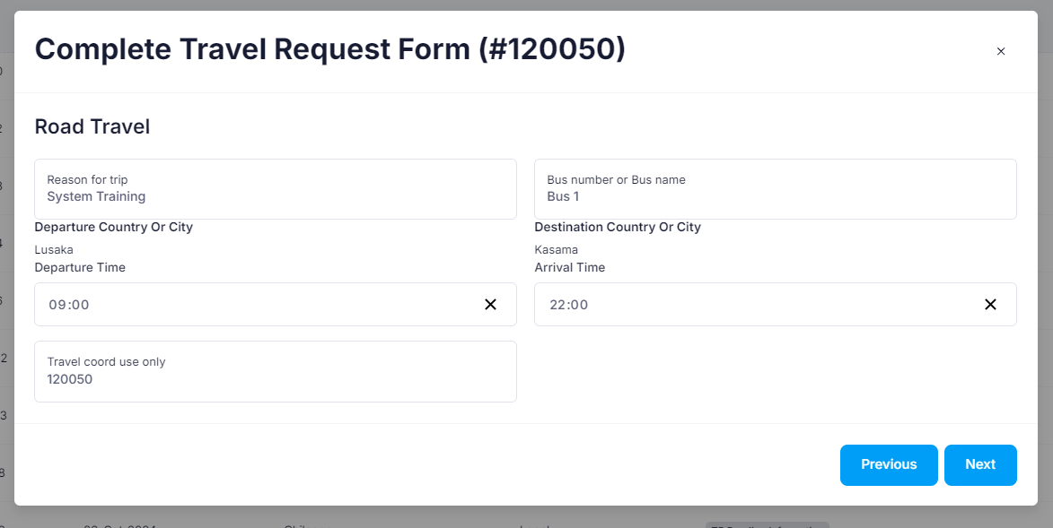
17. Complete TRF
Fill out the form with the necessary information. The system will automatically pull the departure and destination city/country based on the scope of work that was submitted.
Click on the previous button to go back to the previous page. ]
Click on the next button to move on to the next page once you have captured the necessary details on this form.

Slide 31
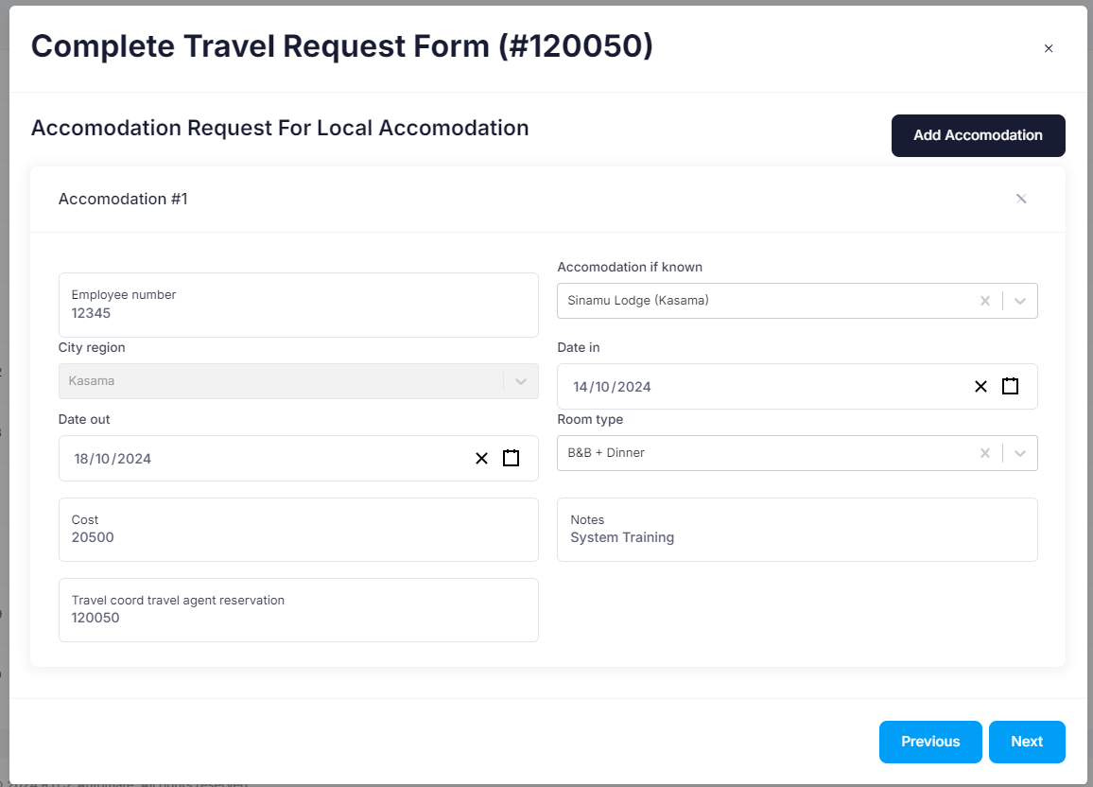
17. Complete TRF
Fill out this form with the necessary information regarding the accommodation for the travel request. The system will automatically pull accommodation options that are situated in your destination city.
Click on the previous button to go back to the previous page.
Click on the next button to move on to the next page once you have captured the necessary details on this form.

Slide 32
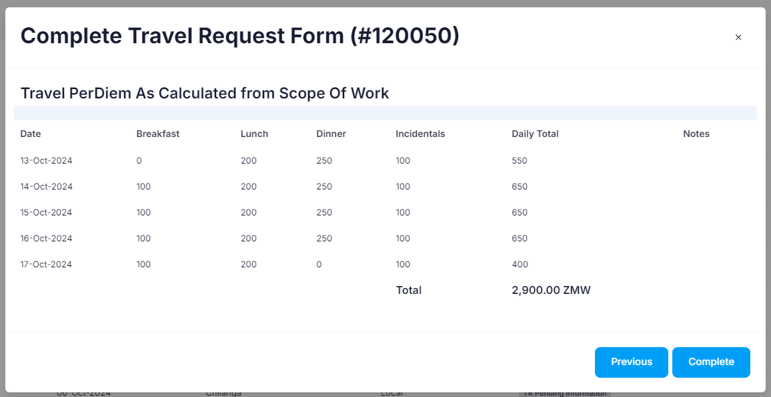
17. Complete TRF
The system will calculate the PerDiem based on the accommodation you have selected and the duration of your stay as well as meals that will be provided to the requester.
Click on the previous button to go back to the previous page.
Click on the complete button to submit your travel request form.

Slide 33
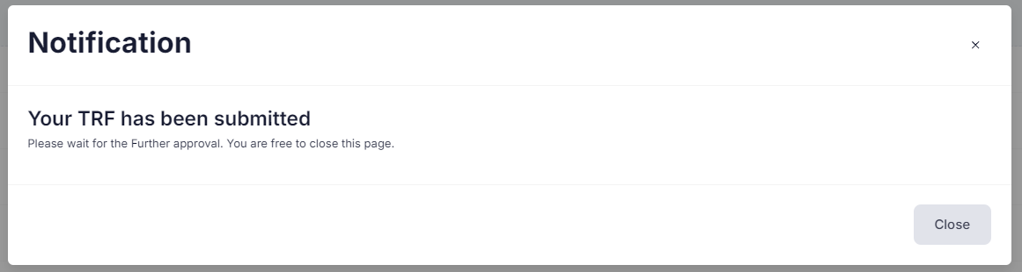
17. Complete TRF
Once the travel request form has been completed and submitted, you will get this pop-up notification.

Slide 34
18. Approver - Login
Capture your email address as the username
Capture the password from the registration confirmation email.
Click on the submit button to login to the system.

Slide 35
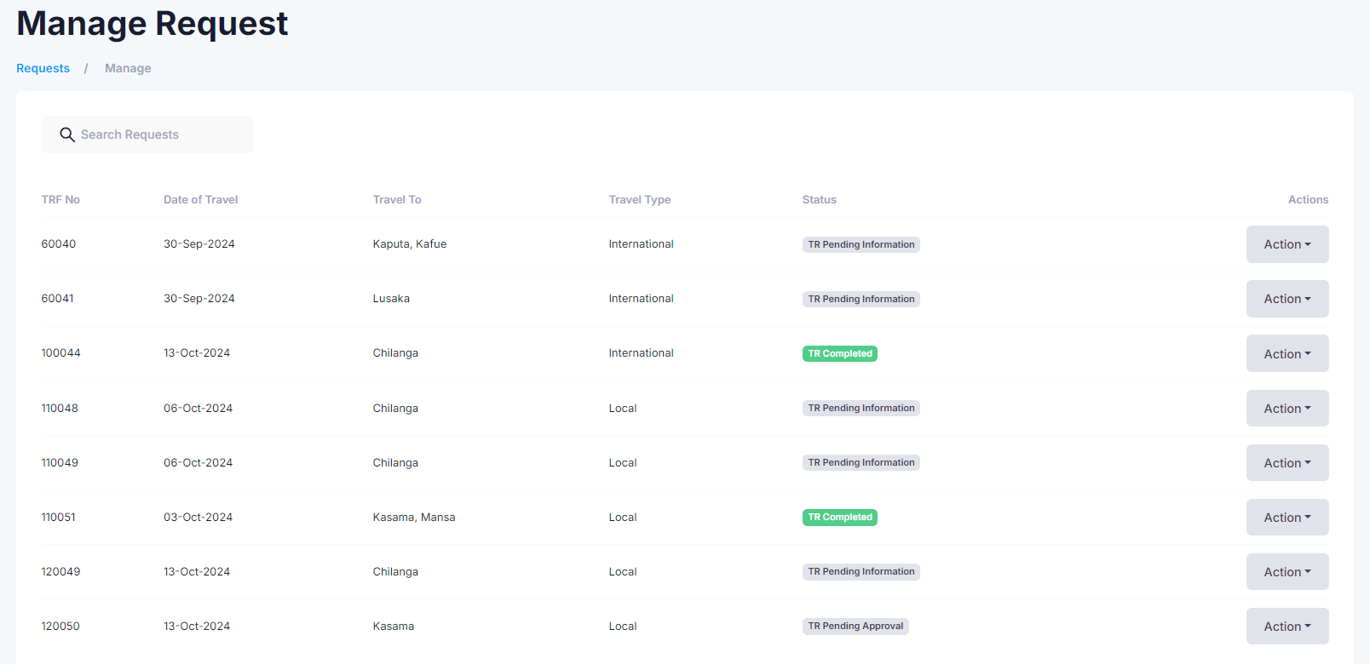
19. Approve TRF
Click on the Manage TRs button. The system will then direct you to the Manage Requests longitudinal view page.

Slide 36
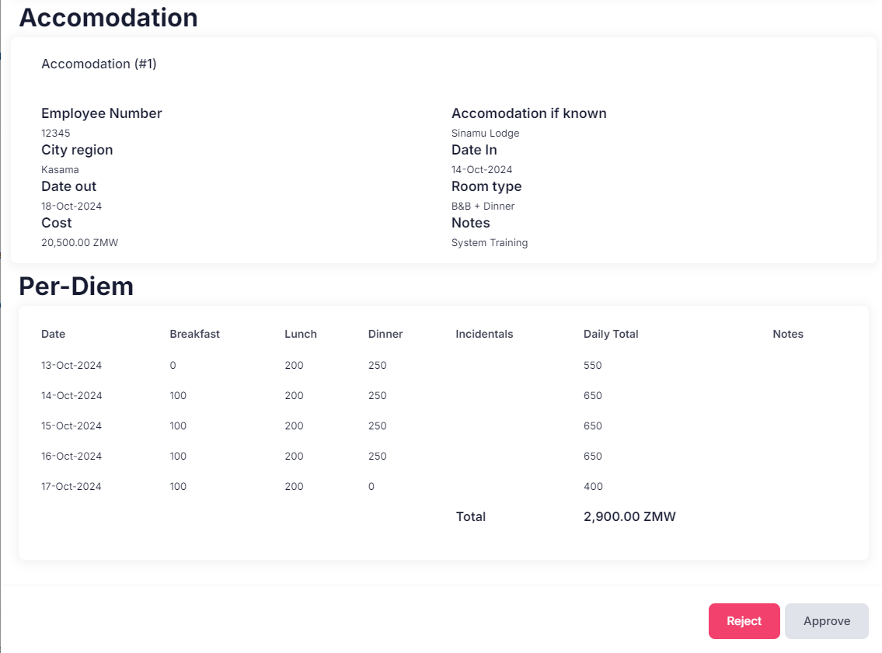
19. Approve TRF
Click on the actions button, then click on the view TRF button.
Scroll to the bottom of the page to see the Approve and Reject button.
To approve the requester’s TRF, click on the approve button.
To decline the requester’s TRF, click on the Reject button.

Slide 37
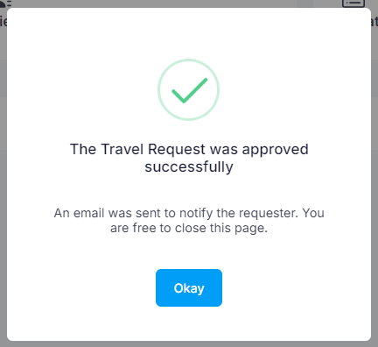
19. Approve TRF
Once the travel request form has been approved, you will get this pop-up notification.

Slide 38
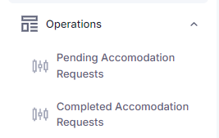
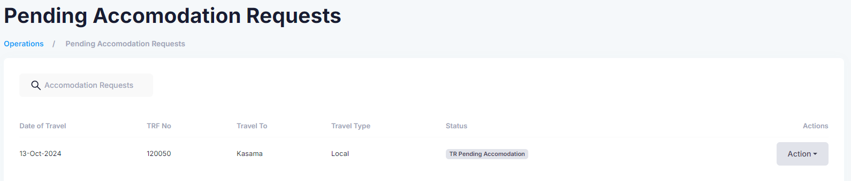
20. Assign Accommodation
Click on Pending Accommodation Requests. The system will the direct you to the longitudinal view page.

Slide 39
20. Assign Accommodation
Click on the Actions button, then click on the Assign Accommodation button to view the TRF.

Slide 40
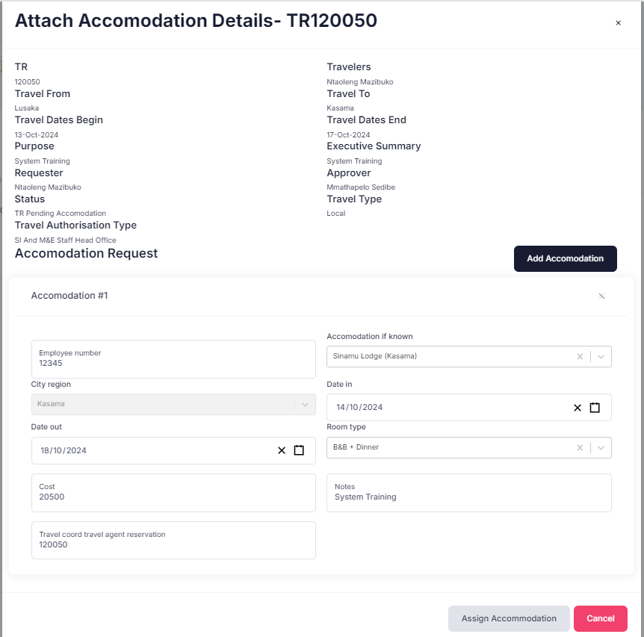
20. Assign Accommodation
Click on the Add Accommodation button if there is a need to add an extra accommodation.
Click on the Assign Accommodation button to complete the TRF process.
Click on the Cancel button to return to the longitudinal view page.

Slide 41
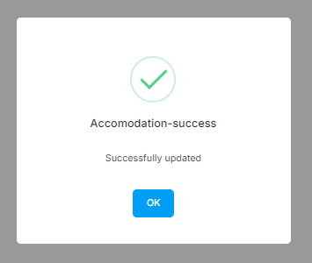
20. Assign Accommodation
Once the accommodation has been assigned, you will get this pop-up notification.

Slide 42
THANK YOU!!!

